Slide 1

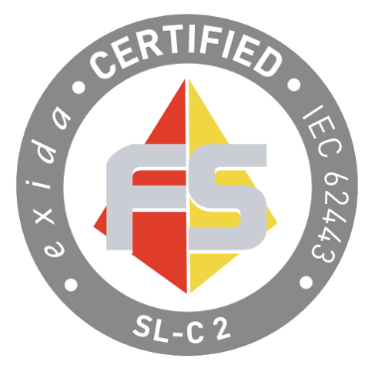
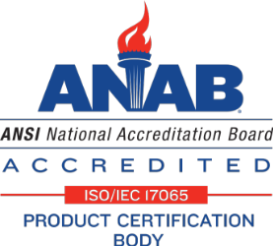



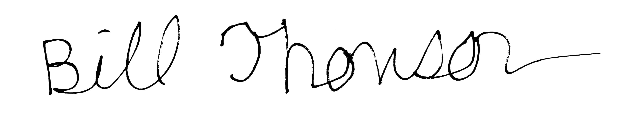
The manufacturer may use the marks:
Certificate / Certificat
Zertifikat / 合格証
JCI 2508133 C001
exida hereby confirms that the
Metasys Network Engines
(SNE/SNC Series)
Johnson Controls International PLC
Glendale, Wisconsin, USA
Certification Report:
JCI 2508133 R002 V1R0
Application Restrictions:
The unit shall be operated in a network and operational environment meeting the assumptions in the product certification report.
Validity:
Product certificate remains valid under the following conditions:
The following SDLA certificate remains valid: ISASecure® SDLA certificate number JCI 2304032 C001 issued to Johnson Controls
Metasys System Version 16.x.x remains under security management practices thereby certified
Revision 1.0 August 07, 2026
Conforms to 62443 requirements listed and to requirements shown:
ANSI/ISA-62443-4-1:2018, IEC 62443-4-1:2018 Secure product development lifecycle requirements
ANSI/ISA-62443-4-2:2018, IEC 62443-4-2:2019 Technical security requirements for IACS components
Meeting Requirements for:
ISASecure Component Security Assurance (CSA) 1.0.0 Capability Security Level 2 requirements for embedded devices, referencing errata CSA-102 v1.9
The normative documents and issue dates that define this certification are listed at www.isasecure.org
Assessment | Subject under Assessment | Date | Current releases at time of assessment
ISASecure® CSA evaluation | Metasys Network Engines (SNE/SNC Series) | 06/10/2026 | 16.0.1
#1004
ISASecure Chartered Laboratory:
exida
80 North Main St.
Sellersville, PA 18960
License: ISCI-CL0001
ACLASS Cert No: AT-1531
Place embossed
seal here for
originals, lining it
up at the bottom
Hrishit Joshi, Evaluating Assessor
Bill Thomson, Certifying Assessor
T-245 V1 R5

