Slide 1
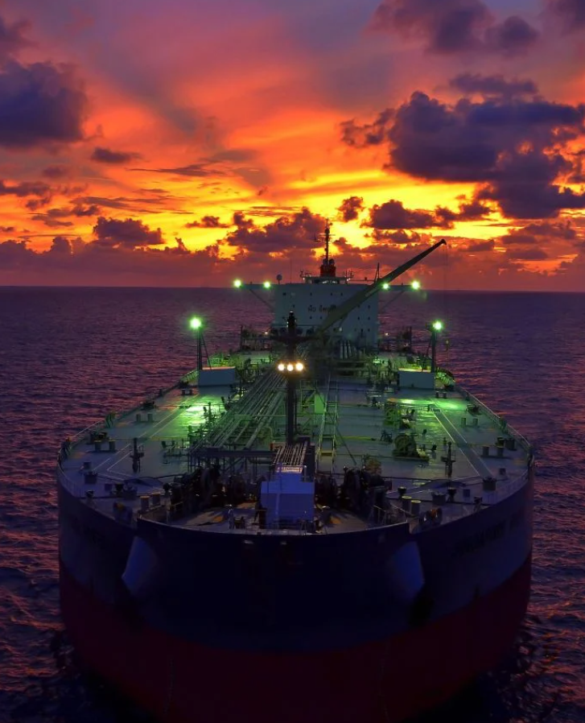

ICS4ICS Exercise:
Marine Shipping
Sept 19, 2024

Slide 2

Rear Admiral John W. Mauger, USCG(ret.) has over 33 years of leadership experience in the maritime industry, national security, and cyber operations. Known for his foresight, innovative approach, and ability to drive change, John has had a positive impact on every role he’s undertaken—from commanding complex Coast Guard operations to shaping the future of cyber defense.
As Commander of the First Coast Guard District, he led over 12,000 people and oversaw critical port operations in New England, deploying innovative technologies like counter-drone systems to enhance security. John's leadership during the TITAN capsule search and recovery at the TITANIC site highlighted his ability to lead complex crises in the international spotlight.
At U.S. Cyber Command, John revolutionized cyber training. He led the development of a cloud-based environment that modernized cyber training and exercises and increased readiness.
Earlier in his career, John led key regulatory projects for both domestic and international shipping. His work protected mariners and the
environment, created new markets for alternative fuels, and established a new international code to safeguard vital Polar regions.
Now leading (PORTS) LLC, John uses his diverse expertise to help clients plan for and navigate complex challenges in the maritime and critical infrastructure sectors while enhancing personnel and team performance through effective training.

Slide 3
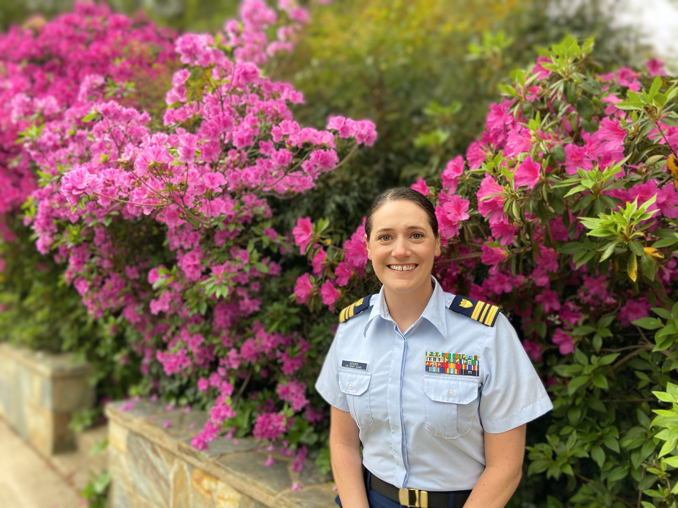
LCDR Hillary Adams is the Maritime Cyber Readiness Branch Chief at Coast Guard Cyber Command (CGCYBER) in Washington, DC. In this role she directs support to the Marine Transportation System (MTS), investigates cyber incidents affecting vessels and MTSA regulated facilities, and liaises with industry partners to share information and protect MTS critical infrastructure.
LCDR Adams has previously served at the USCG Cybersecurity Policy and Program Management Office (CG-62), Sector Northern New England, Maritime Intelligence Fusion Center Pacific (MIFC PAC), and as a Deck Watch Officer on CGC MOHAWK homeported in Key West, FL.
LCDR Adams earned a Bachelor of Science degree in Marine Environmental Science from the Coast Guard Academy in 2011 and a Master of Science degree in Management of Information Technology from the University of Virginia in 2020. Her professional certifications include DHS Program Manager Level II, Contracting Officer Representative (COR), ISACA Certified Information Security Manager (CISM), and ISC2 Certified Cloud Security Professional (CCSP).

Slide 4
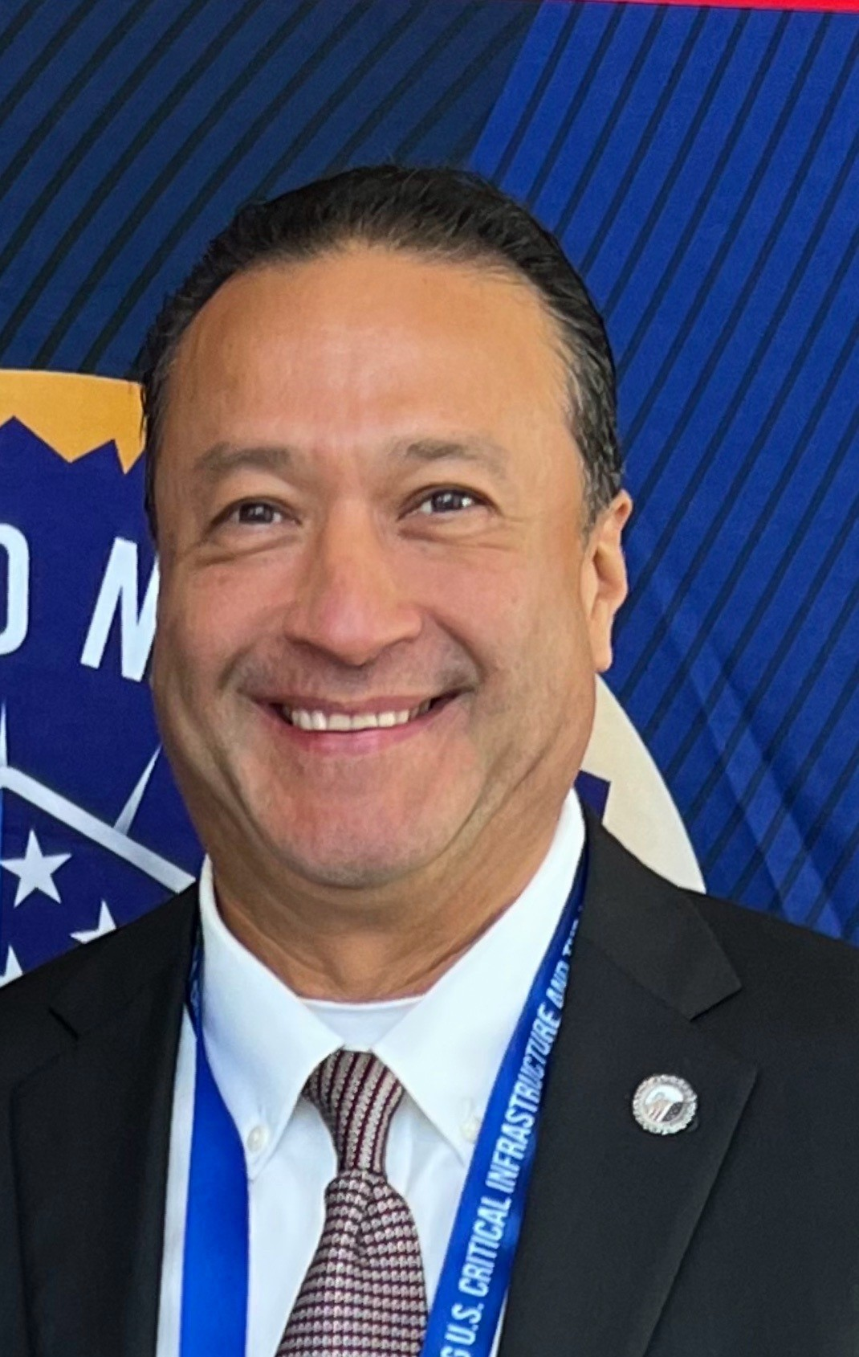
Marco Ayala is the President for the Houston Members Alliance who has over 29 years of experience where he designed, implemented, and maintained process instrumentation, automation systems, safety systems, and process control networks. In his role with large global manufacturing company, he is responsible for applications globally that are specific to plant site operations and corporate governance.
With around two decades focused specifically on industrial cybersecurity, he has led efforts to secure the oil and gas (all streams), maritime port, offshore facilities, and chemical sectors, supporting federal, local, and state entities for securing the private sector.
Marco is highly active in International Society of Automation and is a longtime member. He is a 22-year Senior Member and a certified cyber instructor for ISA (62443) with volunteering commitments and contributor to the AMSC Gulf of Mexico (GOM) cybersecurity committee in a sworn in role to the USCG as Chair of Threat Intelligence and Cybersecurity for the outer continental shelf (OCS).
InfraGard member since 2014.
Houston InfraGard Members Alliance, President
Email: marco.ayala@infragardhouston.org

Slide 5


Brian Peterson is an Information Risk Consultant who works for ISAGCA as the ICS4ICS Program Manager. He also works for other companies as a program and project manager and conducts research related to IT systems, applications, and SCADA/DCS systems, such as those used in the oil and gas, manufacturing, and other industry sectors.
International Society of Automation| ICS4ICS Program Manager
Email: bpeterson@isa.org

Slide 6
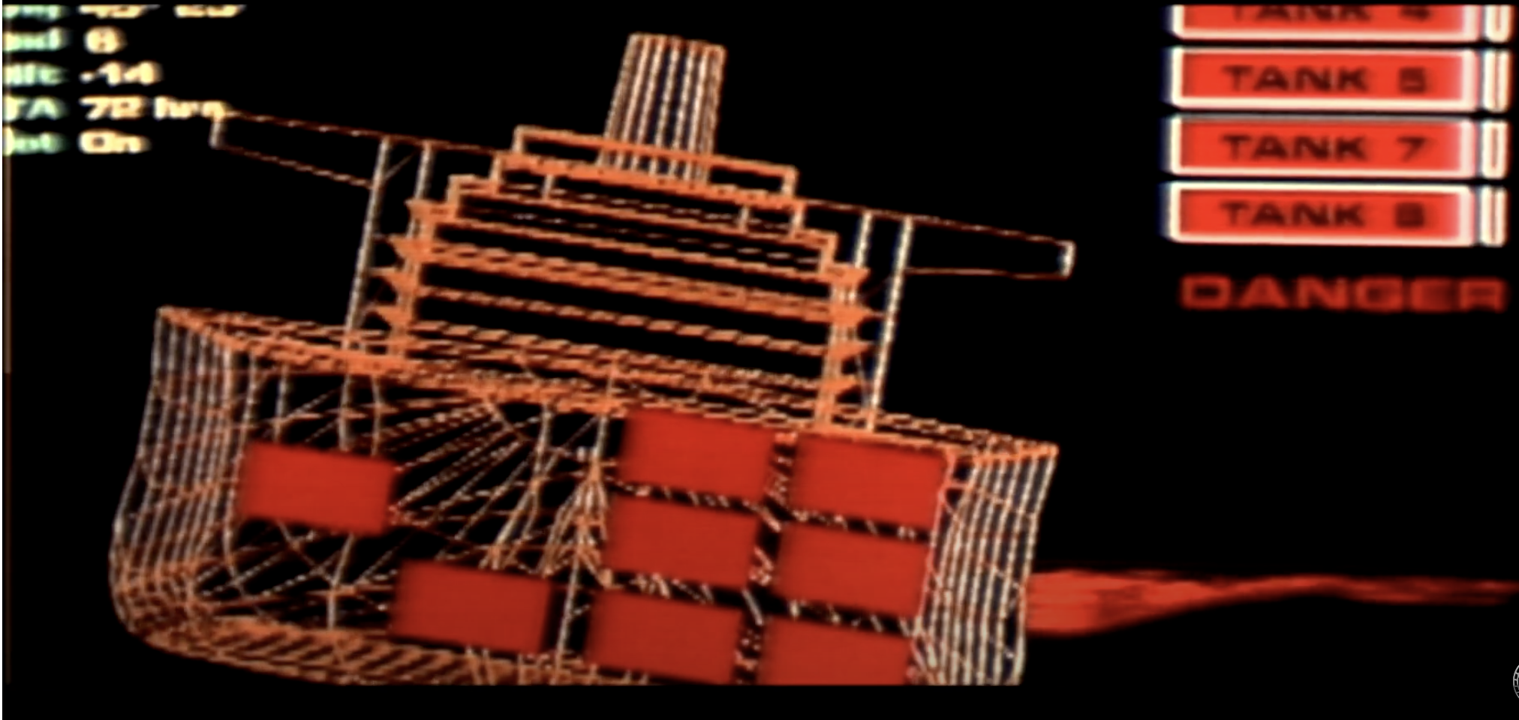
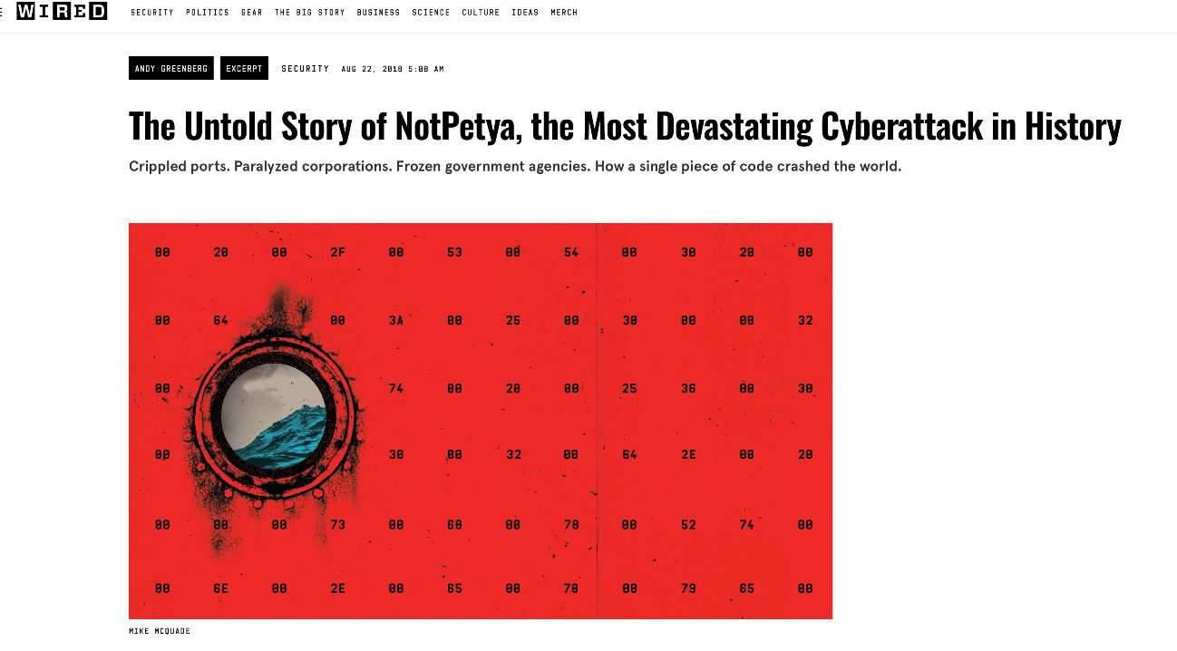
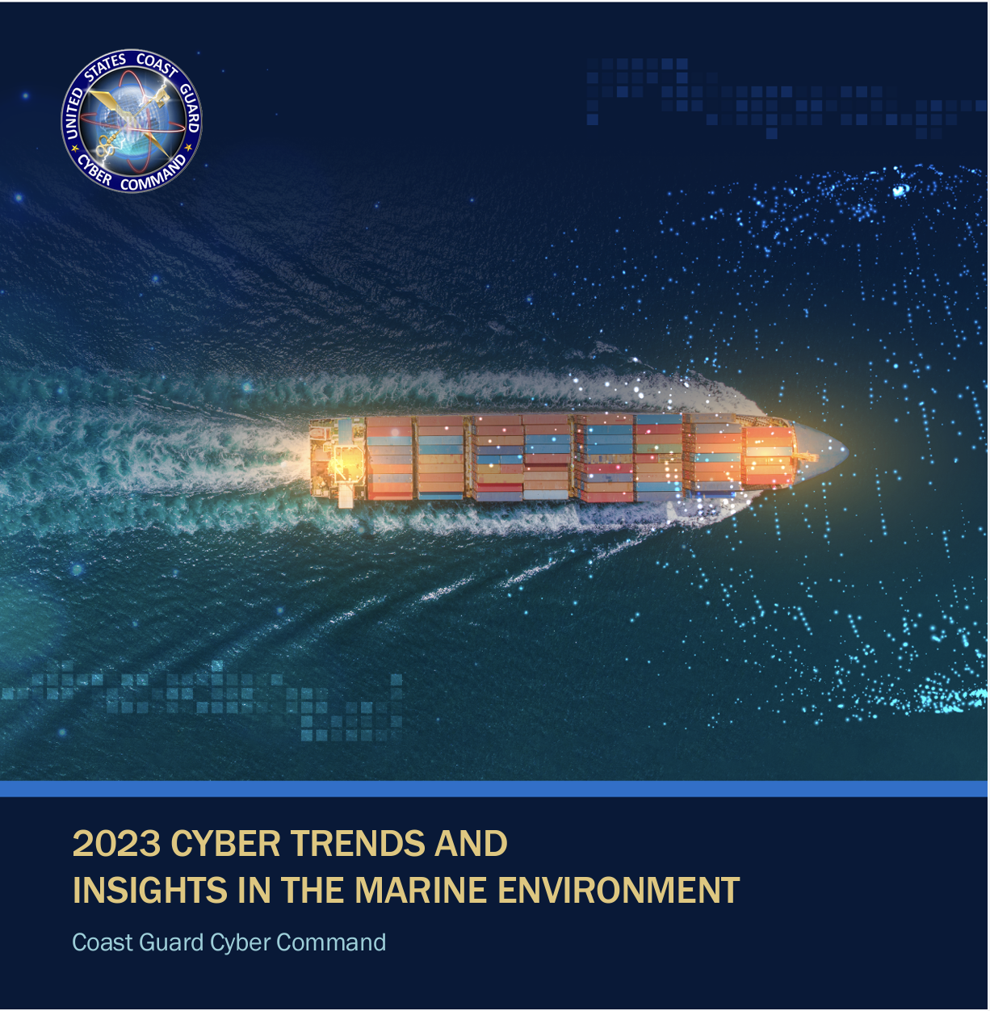
Exercise Kick-off
Cybersecurity is critical to ensure the safety of Shipping
Maritime Cyber
in Numbers:
DaVinci virus threatens to sink oil tankers…
95% | $5.4 T | 33 M
700 K | 70% | 94.4%
Maritime cyber threats, from fiction to fact…
Notes:
The numbers:
First line is from President’s E.O. and news release on maritime cyber: https://www.whitehouse.gov/briefing-room/statements-releases/2024/02/21/fact-sheet-biden-harris-administration-announces-initiative-to-bolster-cybersecurity-of-u-s-ports/#:~:text=President%20Biden%20will%20sign%20an,networks%20and%20systems%20are%20secure.
Second line is from: https://purplesec.us/resources/cybersecurity-statistics/ and the CTIME report
https://www.news.uscg.mil/maritime-commons/Article/3750095/2023-cyber-trends-and-insights-in-the-marine-environment-report/

Slide 7
ICS4ICS: Tabletop Exercise Objectives & Rules
This will be a different exercise to create awareness and help you deploy ICS4ICS
Objective 1: Understand how the Incident Command System improves cyber incident response efforts through management and administration
Objective 2: Foster improved communication channels among Incident Command, OT, IT, and Operations teams
Objective 3: Detect and address deficiencies within existing incident response frameworks, procedures, and plans
Rule 1: Accept the scenario as feasible and engage with the events as they are outlined—reality within this exercise is what the scenario presents
Rule 2: Understand that multiple solutions may be effective. There isn’t necessarily one "correct" response
Notes:
This exercise is more of a demonstration of the ICS4ICS capabilities which are applied to the marine industry specific to a cyber attack of a ship.
These are the ICS4ICS Exercise OBJECTIVES and Rules for the exercise.
You will learn to leverage the Incident Command System to manage Incident Response efforts
Another objective is to enable you to Improve communication between Company Executives, Incident Command, OT, IT, and Operations teams
Our goal is to identify gaps in incident plans, structures and processes
The first rule is that the scenario is plausible, and events occur as presented
Do not “fight” the scenario
The second rule is to understand that multiple solutions may work to address this exercise scenario. We are presenting one approach but there is no correct answer.

Slide 8
ICS4ICS Improves response to cyber industrial incidents
By leveraging 3 disciplines with proven capabilities and benefits
Bringing together existing disciplines
ICS4ICS Benefits
Incident Command System
  Command structure to manage incidents used since the 1970’s
Cyber Security: Computer Incident Response
  Investigation capabilities to manage cybersecurity incidents that are widely used by IT organizations
Industrial Control System
  Experts with Industrial knowledge and expertise to respond to incidents
ICS4ICS
Incident Command
Industrial Control
Cyber Security
Standard Approach
Proven Effective
Unity of Command with typing of resources
Clarity of Responsibilities
Span of Control
Common Terminology
Adaptability to size/complexity
Planned/Unplanned events
Unity of Effort
Accountability
Staffing alternatives, mutual aid
Notes:
ICS4ICS combined 3 capabilities that already exist in most companies. The goal is to improve management of cybersecurity incidents that impact Industrial Control Systems. These capabilities can be used for non-cyber incidents that impact industrial operations.
The NIMS/Incident Command System was created in the 1970’s. There are similar versions used in numerous countries.
Cybersecurity teams leverage Computer Incident Response processes defined by NIST and other organizations to investigate cyber incidents with the goal to minimize the impact of incidents, and provide information needed by leadership that enables them to quickly make decisions that lead to the resolution of incidents.
Industrial Control System experts currently manage the technical aspects of many type of incidents including cybersecurity incidents. Their knowledge of their systems enable them to identify alternatives to recover critical business functions they support and respond to cyber incidents.
ICS4ICS combines these three processes and leverages the unique expertise of each group to expedite the response and resolution of cybersecurity incidents.
The Incident Command System is used every day by First Responders and is part of the National Incident Management System, also known as NIMS. NIMS was mandated for the US government by Homeland Security Presidential Directive 5 (HSPD-5) issued in 2003.
The Incident Command System provides a Standard Approach. The coordination process and management strategies are the same for all responders regardless of the type of incident.
The system was born from decades of emergency management activities which makes it very effective
Unity of command allows everyone to know their role and who they report to
Clarity of responsibilities is accomplished because everyone is assigned a role, a title, and a list of tasks
Span of Control limits the number of people and tasks a supervisor is reasonable able to manage
Common Terminology ensures that everyone speaks the same language
Adaptability means Incident Command is a very flexible system, it can be used for an incident of any size and complexity; The ICS4ICS team can also grow or shrink based on the needs of the evolving incident
Planned and unplanned events can be managed by the Incident Command System
The system ensures there in no duplication of efforts. We don’t want multiple parties working on the same tasks
Accountability is easily achieved since everyone is assigned a specific role/title/task and duty. Therefore, each person is accountable for their actions. Accountability during incident operations is essential. The NIMS/ICS structure will need to abide by company policies and guidelines and any applicable laws and regulations.
xxx

Slide 9
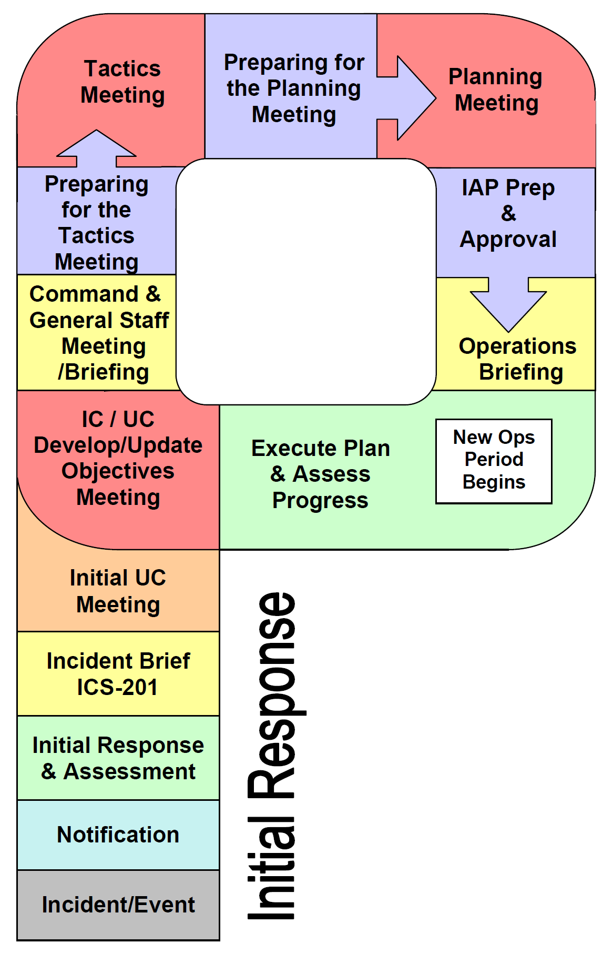
Planning P
Incident Command Process
Offers a proven, structured methodology for incident management.
Ensures standardized organization and execution of tasks.
Delineates a clear sequence for meetings and briefings.
Employs Incident Command System forms and worksheets.
Systematizes actions and work products of team members for cohesive, efficient response.
Notes:
The Incident Command System has a Planning P process to manage All-Hazards. The Planning Cycle consists of the detailed steps necessary to guide the ICS4ICS Team through the five phases of the planning process to develop, disseminate, implement, and adjust an Incident Action Plan (IAP) based on the Incident Objectives.
The All-Hazards Planning Cycle provides a systematic, standardized, and effective approach to organizing response to incidents. After the initial response, the Planning P defines the operational cycle which is repeated. The Planning P operational cycle likely will be repeated multiple time even as a new shift of staff arrives to staff the effort. Planning P provides structure by:
Prescribing the order in which meetings or briefings occur. AND
Identifying the person responsible for collecting incident data and the parties who will make decisions. AND
Defining the actions and work products that are assigned to each of the ICS4ICS teams
We’ve developed Training Videos that explain ICS4ICS and the Incident Planning Process. If you have not seen these videos, you can view the Training by visiting the ICS4ICS website.

Slide 10

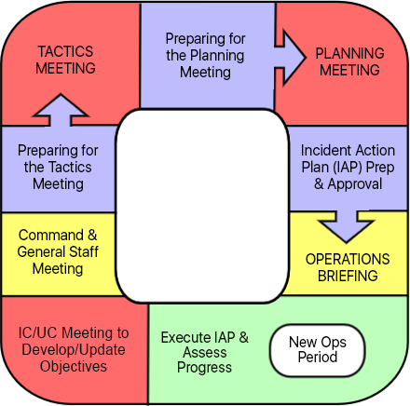









ICS4ICS Meetings, Briefings, and Work Sessions
Over a 12-hour period and identification of critical people
0000/1200
HOURS
All Members
0200/1400
HOURS
OSC
PSC
SOFR
LSC
IC
FASC
LSC
PIO
And Cooperating Team(s)
All Members
OSC
PSC
SOFR
2200/1000
HOURS
All Members
All Members
0530/1730
HOURS
Meeting
START
1800-0600
HOURS
All Members
Briefing
IC
PSC
Working
Notes:
Some of the meetings repeat similar agendas because pre-work is needed, and new attendees are added to subsequent meetings.
The Planning P Meetings only include ICS4ICS Team members who are needed to accomplish the agenda of each meeting. Other people are working independently on their action items and/or collaborating as needed to prepare for their future meetings and action items.
The Incident Commander and Planning Section Chief attend the Incident Commander Objectives Meeting
All ICS4ICS Team members attend the Command & General Staff Meeting; after the meeting, all team members will work to prepare for the Tactics Meeting or work on other action items
The Operations Section and Planning Section Chiefs meet with the Safety Officer at the Tactics Meeting and may be joined by the Logistics Section Chief who provide advice
The Planning Meeting includes most of the ICS4ICS Team members and may include business team representatives who provide input
The Operation Section and Planning Section Chiefs work with the Safety Officer on the IAP Prep and approval work; Most other ICS4ICS Team members will also be working to prepare for the Operations Briefing
All ICS4ICS team members participate in the Operations Briefing to get execution plans that they can share with the 2nd shift
The Incident Commander will initiate a 2nd shift if the incident is not under control; and everyone will start executing the plan

Slide 11
Defining ICS4ICS roles needed to manage the incident
ICS4ICS team organization will be defined by the Incident Commander
Unified Command (Physical and Cyber)
Incident Commander
Public Affairs
Public Information Officer (Comms)
Legal Counsel
Safety
Safety Officer
Liaison Officer
Gov reporting,
Industry partner,
Others…
Cybersecurity or IT Manager
Operations Section Chief
Planning Section Chief
Facilitator
Logistics Section Chief
Logistics
Admin/Finance Section Chief
Finance
CIRT Analyst
ICS Systems Analysis
Resources Unit
Cyber Support Specialist
Procurement
External Technical Team
IT Analyst
Documentation Unit
Communications Unit
Insurance Claims
Food Unit
Cost/Timekeeper
Notes:
The ICS4ICS organization includes roles that may not be staffed initially for smaller incidents. The IC determines what roles to staff.
This org chart is an example of what the ICS4ICS organization may look like for your industry
The Incident Commander is empowered by company leadership through DOA and makes decision for the ICS4ICS Team; Executives will identify the person to fill this position
A PIO is needed for all incidents to ensure messages are managed and communicated.
A Safety officer ensures the safety of the ICS4ICS team, company staff and contractors, and the communities where we operate.
One or more Liaison Officers may be appointed to interface with the Government, customers, investors, and other specific to your industry
The Operations Section Chief manages the technical team and staff who investigate and try to resolve the cyber incident; The IT, Cybersecurity or other manager may be appointed to this position
The Planning Section Chief facilitates the ICS4ICS process and meetings; They are responsible for ensure documentation is created to allow shirt turnover and to meet legal requirements.

Slide 12

Notes:
The ICS4ICS exercise will begin with background information.

Slide 13
Scenario: Ship Information
Size of the ship and requirements
100,000-ton LNG ship with explosive materials located in USA waters in Boston MA is involved in this scenario (Panama flagged ship)
Vessel size triggers IMO requirements for ECDIS carriage.
    ECDIS (Electronic Chart Display Information System) for ships has gained popularity over the years and has become a real necessity for safe navigation at sea. The mandatory carriage of ECDIS has been implemented on almost all ships depending upon the type and gross tonnage of the vessel. It is widely believed that ECDIS will be an essential aid for safe navigation.
      Reference: https://www.marineinsight.com/marine-navigation/order-electronic-navigation-charts-and-keep-them-updated/
    Requirement: Electronic Nautical Charts (ENC) and Electronic Chart Display and Information Systems (ECDIS) (imo.org)
Vessel size also requires the vessel to have a backup system
    Requirement: https://imorules.com/GUID-7B89276D-B0C2-40AE-B667-769791BB887D.html

Slide 14
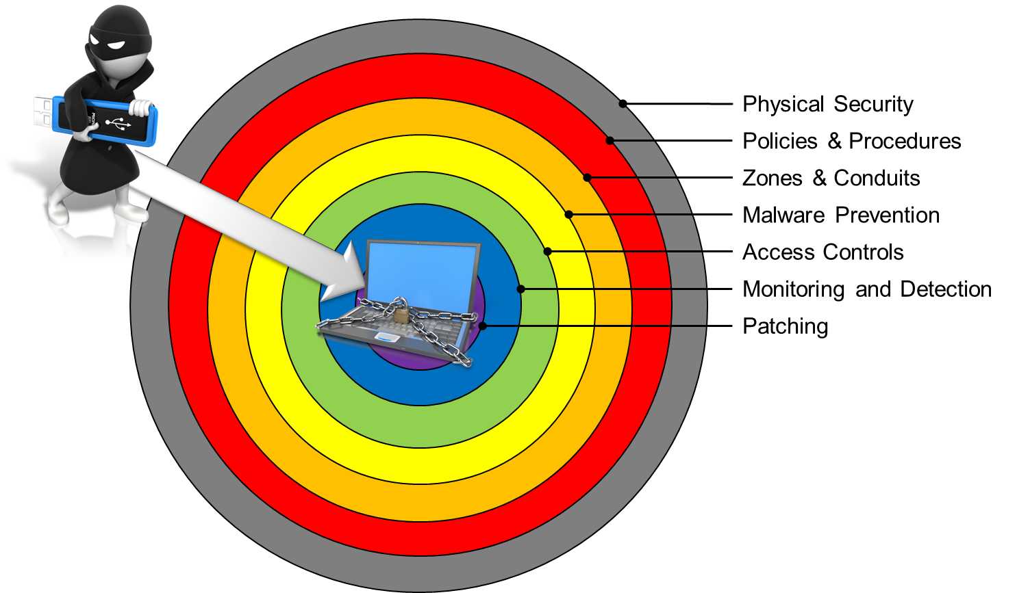
Cybersecurity provide protection
Layered Approach to Protection
“Defense in Depth”—Implementing Layered Security in a Stratified Approach
Policies
Other Work Processes
Configuration
Problem Resolution & Support
BCP/DR
Risk/Vulnerability Assess.
Incident Response
Programming/Testing
Cybersecurity Program
Staff training/work processes
Asset Register/Management
Procedures
Notes:
Cybersecurity capabilities are deployed to provide multiple layers of protection.
No single cyber defense measure (no Silver bullet) that can absolutely protect against cyber attacks
We rely on layers of cybersecurity capabilities, called defense in depth. The intent is to delay or completely prevent an attack. An attacker must break though numerous layers to successful attack the environment. !! These layers include:
Physical Security of assets and the components and systems that are used to operate those assets
Cybersecurity policies and procedures, including user training,
Zones & Conduits separate network segments with a protective device
Anti-Malware solutions prevent various forms of malware from compromising the environment
Access Controls are critical because weak unauthorized access has caused numerous cyber attacks
Monitoring and Detection helps quickly identify potential attacks so immediate action can be taken to limit their consequence and prevent an event from escalating into an incident
Patching has remained an important measure to prevent known vulnerabilities in software
Other Work Processes that are important to protecting your environment are shown on the right side of the slide
Even if more than one layers of protection fails, the other layers are designed to prevent or limit the impact of attacks

Slide 15
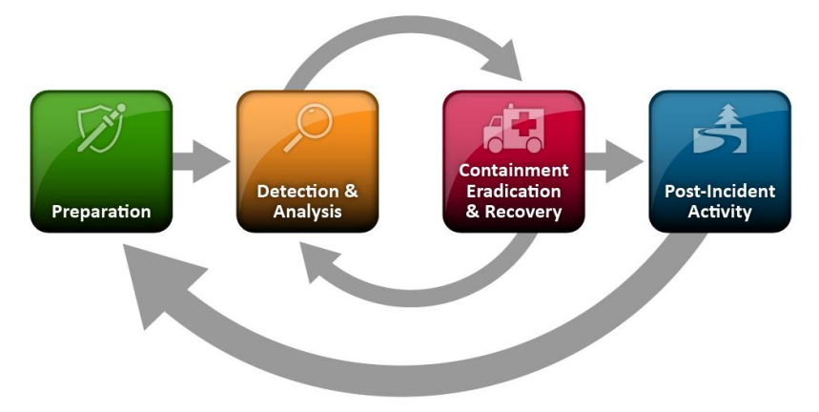
Computer Incident Response Team (CIRT) process
Phases of Incident Response
Event escalation occurs post-analysis, in alignment with NIST guidelines.¹
PREPARE with strategic planning and staff training exercises.
DETECT events by identifying attack vectors and indicators.
ANALYZE, prioritize, and escalate events as necessary.
CONTAIN the incident to reduce further damage.
ERADICATE the source of the event.
RECOVER and restore systems to normal.
CONDUCT POST-INCIDENT reviews for lessons learned and evidence retention
Forensics can be involved at any phase.
¹NIST SP 800-61 Rev. 2, Computer Security Incident Handling Guide
Notes:
Most organizations have Computer Incident Response capabilities. This includes a plan and staff who are trained and participate in regular exercises to ensure they are ready to respond to a cybersecurity incident.
Detection of events is an important aspect of any cybersecurity program. Numerous events are identified by detection tools and log messages from applications, servers, and network devices. A large company probably has millions of events occurring daily.
A Computer Incident Response Team (CIRT) analyze events to identify those that present a potential risk and require further investigation and possibly additional action.
The CIRT takes immediate actions to contain events to prevent them from causing additional negative consequences.
They also eradicate the source of the event and if necessary, take actions to restore data and systems.
A Post-Incident review is completed to understand how these CIRT processes can be improved and to retain evidence from the event.
This flowchart is based on CIRT 800-61; Most CIRT processes uses very similar processes

Slide 16
Scenario: Ship Cybersecurity Requirements
Understanding cybersecurity requirements
  The flag states utilize a classification society to establish security requirements that must be met for the vessel to be registered.
    Generally, these requirements meet International Maritime Organization (IMO) expectations.
  Ship Security Plan must include a cyber component
Cybersecurity Standards commonly used in the maritime industry
  ISA/IEC 62443, NIST 800-53/82, NIST CSF and CIRT, etc.
  CIRT processes are based on regulations and/or standards
    ISO/27000 Annex (Europe)
    USCG Assessment process follows NIST CSF (USA)
  US government tiered (national, sector, sub-sector) cyber risk management strategy:
    Executive Order 13636: Improving Critical Infrastructure Cybersecurity (cisa.gov)
    NIPP 2013: Partnering for Critical Infrastructure Security and Resilience (dhs.gov)
    Transportation Systems Sector | Cybersecurity and Infrastructure Security Agency CISA
    national-maritime-cybersecurity-plan_20201202.pdf (globalsecurity.org)
  USCG and DOT (MARAD) designated as co-leads for transportation system sector
    There is a whole government response plan involving other government agencies
Notes:
ISA-62443: https://www.isa.org/standards-and-publications/isa-standards/isa-iec-62443-series-of-standards
NIST-800-53: https://csrc.nist.gov/pubs/sp/800/53/r5/upd1/final
NIST-800-82: https://csrc.nist.gov/pubs/sp/800/82/r3/final
NIST CSF: https://www.nist.gov/cyberframework
NIST CIRT: https://nvlpubs.nist.gov/nistpubs/SpecialPublications/NIST.SP.800-61r2.pdf
ISO 27000: https://www.isms.online/iso-27001/annex-a-16-information-security-incident-management/

Slide 17
Scenario: Ship Cybersecurity Capabilities and Support
Understanding cybersecurity risks and support organization
  Cybersecurity Maturity on ships
    Weak passwords and limited to no use of Multi-Factor Authentication (MFA)
    Some ships have old equipment and improper maintenance of that equipment
    Cyber Incident detection is challenging and makes it difficult to determine what type of attack if any is occurring
    Security Information and Event Management (SIEM) consolidates event (log) data centrally
    Cybersecurity program exists but there may use cybersecurity controls that are immature
  Support Staff for Ships
    Security Operations Center (SOC) are often not used on ships to monitor cyber events
    Fleet Mgmt Co. has an IT, OT, and Network staff working at a shore-base (may outsource)
    External (consulting companies) provides 7x24 support for specialist services
  Guidelines for preventing an ECDIS cyberattack:
    SECURE YOUR ECDIS – PREVENT A CYBER ATTACK!

Slide 18
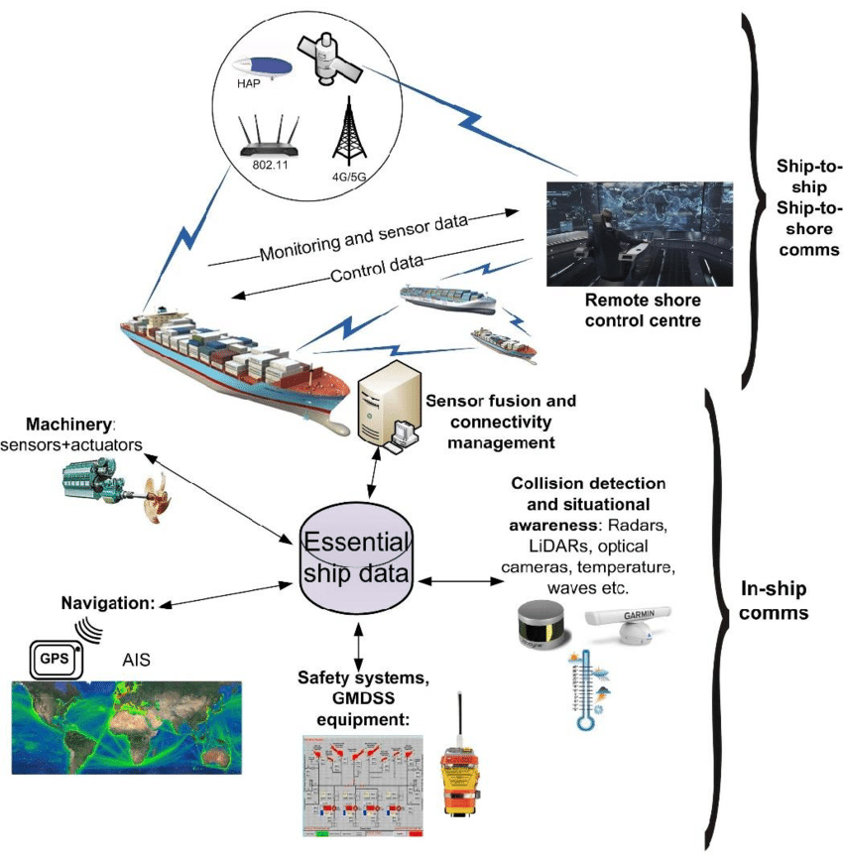
Scenario: Technology on the ship
Understanding the technology environment and risks
  The ship uses satellite for network connectivity to the shore-base
    Using a firewall with different VLANs

Slide 19
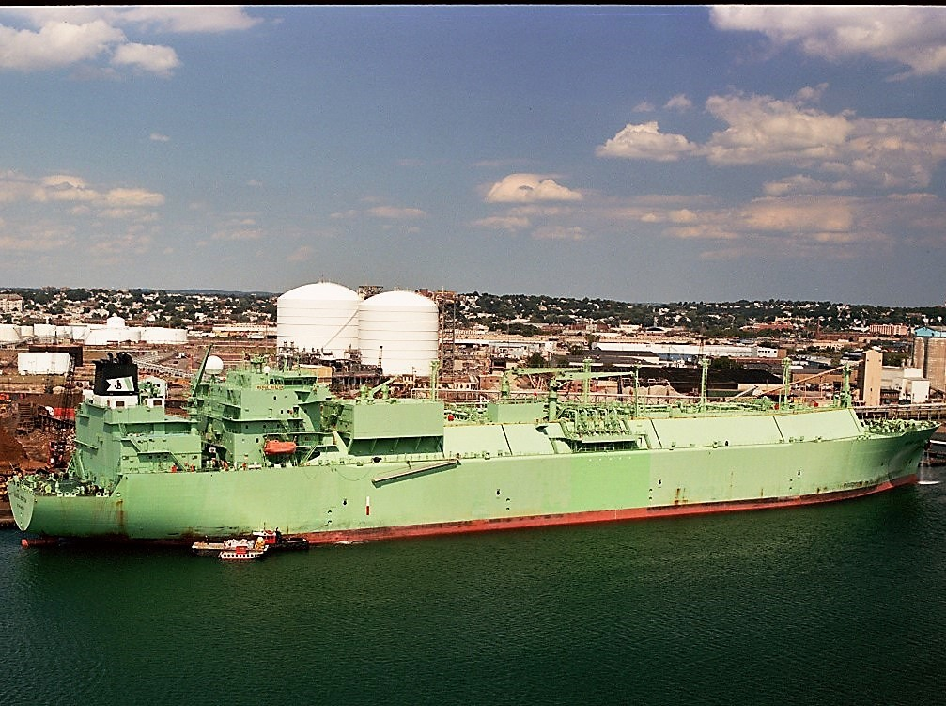
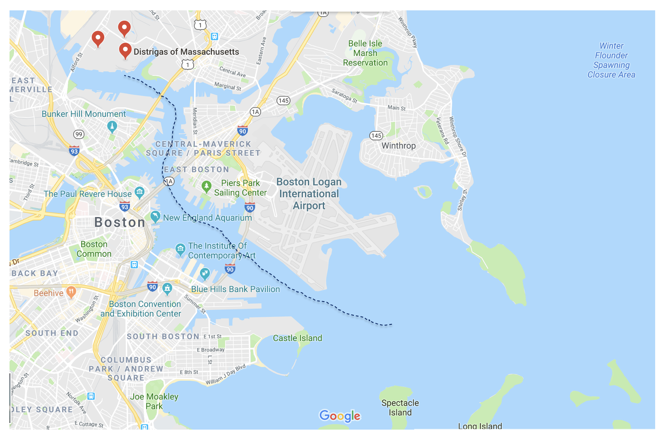
Exercise: BEGINS
TIME: 2000 (8PM)
  A Technician performs routine maintenance work Energy Terminal in a Northeastern Seaboard, MA
  They download map data to the ECDIS system using a memory stick (USB).
  The ship begins its journey to its next destination in the USA

Slide 20
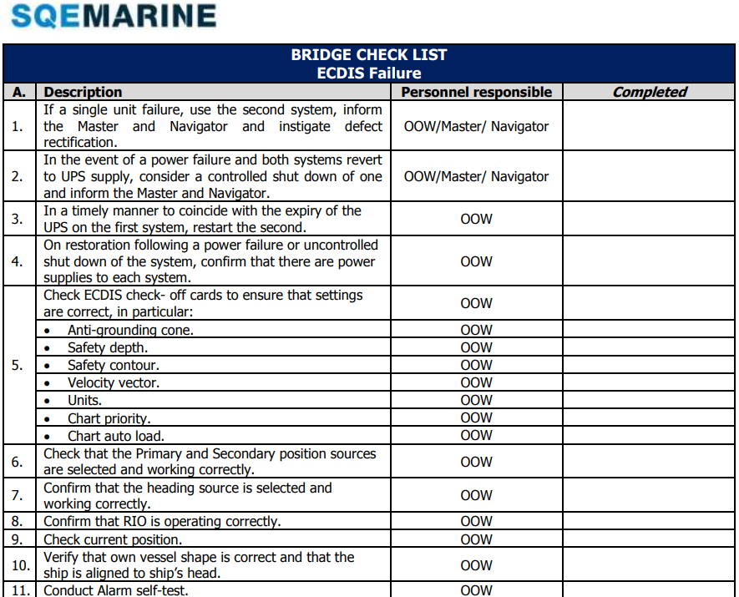
Exercise: Errors and improper operations
TIME: 2200 (10PM)
  ECDIS system is display errors and is not working correctly.
  Officer of the watch is notified of the ECDIS system failure.
  Ship staff initiate a recovery effort using a bridge procedure.
    Reference: SQE-MARINE-ECDIS-failure-2018_05.pdf (safety4sea.com)
  Ship staff cannot easily and quickly recover the ECDIS system

Slide 21
Incident Commander Objectives Meeting
Notes:
The first ICS4ICS meeting is for the Incident Commander to document the incident and develop incident objectives. The Planning Section Chief helps
The ICS4ICS Team members will be travelling to join the team while this work occurs

Slide 22

1st Hour Checklist
Enabling Operations to initially respond and escalate events
Notes:
The operations staff need to have the ability to perform an initial assessment of the problem.
They may be able to solve some problems using existing procedures
They need to understand who they should be contacted to assist with problem resolution if there are not quick fixes
ICS4ICS developed a 1st Hour Checklist procedure template to help you develop a procedure of your operations support staff

Slide 23
1st Hour Checklist
Helping you prepare operations to respond
Preparation
Identify common problems and possible solutions
Define impacts of problem: scope (what ops), impacts (safety, $$, etc.)
Understand how to leverage an inventory (OT, IT, etc.), network/physical maps, etc.
Document criteria when to escalate to support team(s) and their contact info based on type of problem
Reference Containment processes (isolating OT networks)
NOTE: Escalation to IC, IC Declaration, Notification procedure template
Process
Determine the type of problem: system, component, vs. cyber AND impact
If it is a cyber incident, collect forensic evidence
Execute solutions to common problems
Document info about problem, inventory, maps, etc.
Escalate to support staff, if needed
Isolate network based on cyber risks (OT network separation)
Escalate to IC if this appears to be an incident
Notes:
The 1st Hour Checklist template can be used to create procedures for the Operators to follow before they escalate an event to support staff or an Incident Commander
Your organization should prepare a 1st Hour Checklist by identifying common problems along with possible solutions the Operator can use to resolve problems
The operator can document the scope of the problem along with possible impacts, like safety, operations performance, etc.
The procedures describes how the operator can determine the type of problem that occurred like Operational Component failure vs. IT/OT Component failure vs. cybersecurity incident vs. other problems; Inventories of system components may help with this effort
The escalate criteria defines who to call which is based on the type of problem that is occurring, severity of the impact, and other factors. The Escalation and Notification Procedures has these details
The Containment Procedures used to isolate impacted networks to prevent malware infecting other networks is also referenced for the operators to use

Slide 24
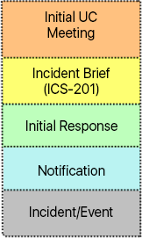
Escalation and Notification then Declaration
TIME: 24:00 (Midnight)
  The Ship Master notifies fleet operations of the problem.
  Fleet operations notify the fleet IT manager who then becomes involved in trying to troubleshoot the problem and recover the system.
  Ship Master (as ICS4ICS Incident Commander) declares incident
    Based on Incident Declaration Procedures
  Ship Master identify ICS4ICS roles required to form ICS4ICS Team
  Critical staff are notified to join ICS4ICS team members
  They are provided instructions to join the team based on Notification Procedures
  The Incident Commander works with the Planning Section Chief
  Document incident and prepare to on-board the ICS4ICS Team members
Notes:
Operators of the automation processes see unusual messages on their display console, which is called a Human-Machine-Interface
The Ship Master will try to resolve the problem before escalating to support staff or the Incident Commander
The Ship Master contacts Fleet Operation if the problem cannot be resolved
The Ship Master, as the Incident Commander is the only person authorized by the C-level suite to declare an incident. This is because declaring an incident will result in money be spent for various incident activities and may start the clock for Government Reporting
The Ship Master, as the Incident Commander, determine the role and people needed to staff the ICS4ICS Team. These people are notified to join the team
The Ship Master, as the Incident Commander works with the Planning Section Chief to document the incident and begin planning for a kick-off meeting with the team

Slide 25
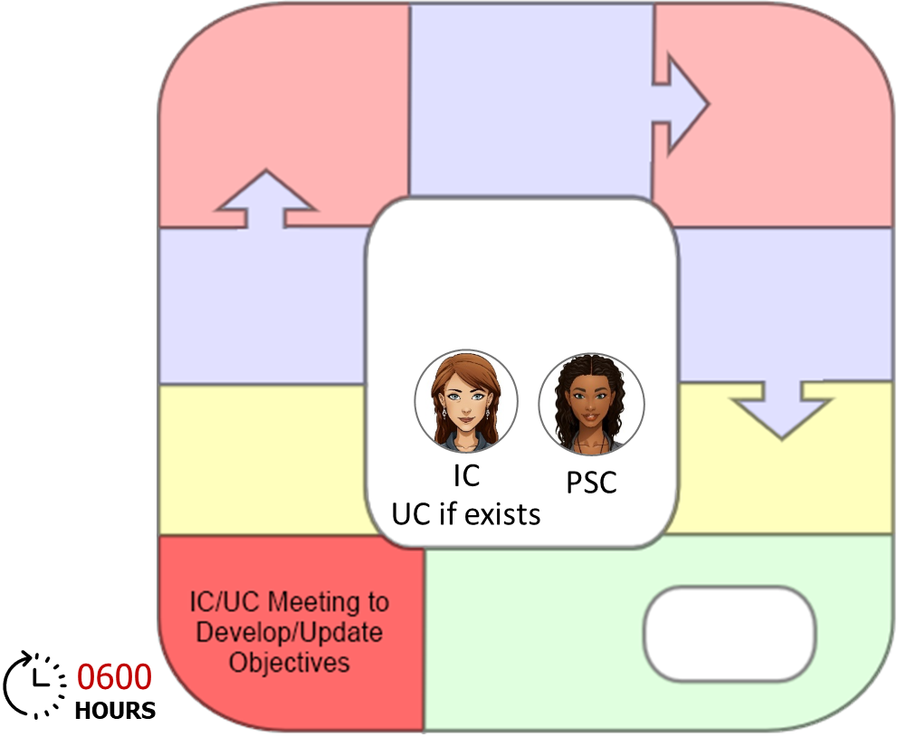
Incident Commander Objectives Meeting: Overview
TIME: 01:00 (1AM)
Ground Rules, Agenda
Incident Chart or ICS-201
WHAT IS HAPPENING HERE
Incident Objectives
CIR/IRT ICS-202 (series)
Notes:
The Incident Commander Objectives Meeting will start at 0600 hundred which is 6AM
The meeting will be attended by the Incident Commander and Planning Section Chief
At this meeting, the objectives are developed and/or identified, which will be captured on a flipchart and the documented on the ICS-202 Incident Objectives form
The Incident Commander will announce the Objectives, and during the Command & General Staff Meeting the staff will review and break down the objectives as either Operational or Managerial and assign to the appropriate sections
The Incident Commander determines the following:
What are the Response priorities, like: life safety a great concern, and/or getting the Industrial Control Systems back online and/or Managing Public Information and/or other priorities
The Incident Commander will also determine Limitations and Constraints of the response which might include labor union challenges, local community concerns like noise, a natural disaster or severe weather, or other constraints
The Incident Commander will be the leader for this exercise; Unified Command will not be required because there is no physical response, like a fire or spill; If a physical response becomes required a Unified Command will be formed

Slide 26
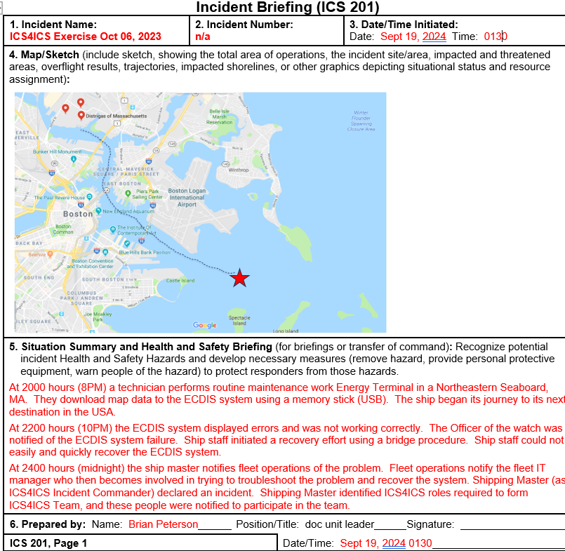
Incident Description
TIME: 01:30 (1:30AM)
Summarize an overview of the incident which typically includes some form of a map
This will be used to on-board people who join the ICS4ICS team and as the basis for internal, media, and other communications
Notes:
The Incident Commander will create the ICS-201 Incident Briefing Sections 1 to 3 showing basic information about the incident
Section 4 shows a sketch of the impacted operations which may be a map or other picture showing the scope of the incident
Section 5 summarizes the incident with information about the incident; We don’t speculate about what might be happening; We only include factual information that we HAVE about the incident
The information about the incident was just presented as part of this exercise to describe the incident scenario; We have taken that information about included it in the ICS-201 form
The information on this form will be used for all communications: First to onboard the ICS4ICS and Cyber Incident Response Team; Then to communicate to media, investors, and other external parties; This information will also be used in Government Reporting and other similar communications

Slide 27
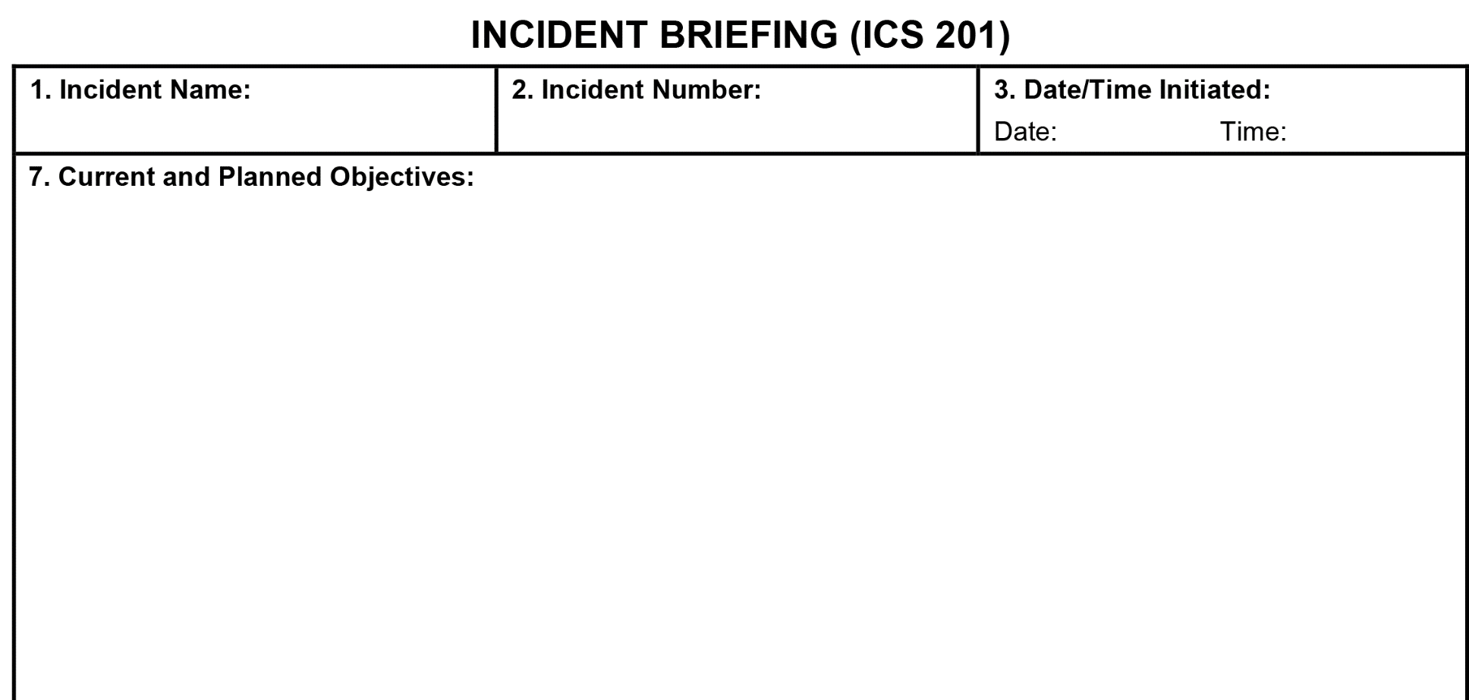
Create Objectives
TIME: 01:30 (1:30AM) - ICS 201 Incident Briefing (Section 7: Objectives)
ICS4ICS WORKSHOP
N/A
09/19/2022
1:30 AM
Ensure safety of staff, Response Personnel and the public
Protect the environment and critical infrastructure of the country
Coordinate incident response efforts with the USCG and other government parties
Maintain proper relationship with the press/media and provide necessary updates
Maintain proper relationship with the stakeholders and ensure adequate/timely updates and proper addressing of the stakeholders' interests
Determine incident mitigation/eradication course of action
Notes:
The Incident Commander will use and modify a template of Incident Objectives that drive incident operations
The Incident Commander decides on operational period which is normally 12-hours
A 2nd shift of people will take over the ICS4ICS team roles, so this team can rest before returning 12-hour later

Slide 28
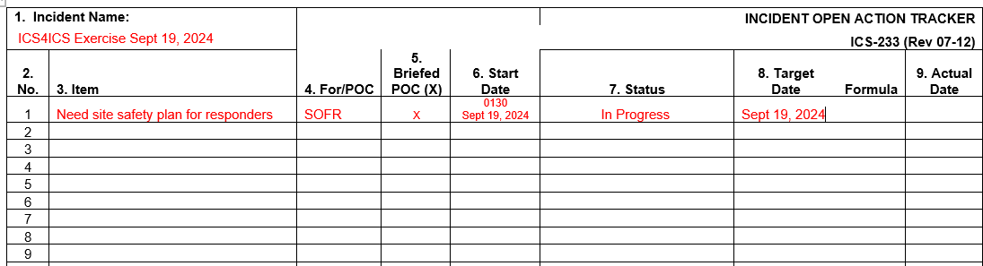
Track Action Items
ICS-233: Incident Open Action Tracker)
Notes:
The Planning Section Chief will capture and update action items for all meetings.
This data will be used to ensure that everyone knows what they have been assigned and ensure all tasks are completed.
This document also acts as a memory for actions have been completed
In this example, the IC has assigned the SOFR (Safety Officer) to develop a Site Safety Plan

Slide 29
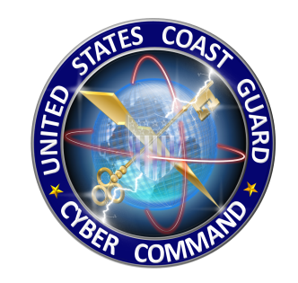
US Coast Guard Reporting Expectations
Understanding USCG Reporting Expectation based the exercise scenario
LCDR Hillary Adams
Maritime Cyber Readiness Branch (MCRB)​
CGCYBER Command

Slide 30
Executive Order on Amending Regulations
Safeguarding of Vessels, Harbors, Ports, and Waterfront Facilities of USA
On February 21, 2024, the Executive Order on Amending Regulations Relating to the Safeguarding of Vessels, Harbors, Ports, and Waterfront Facilities of the United States amended 33 CFR Part 6.
Added a definition for “cyber incident” and created a requirement to report evidence of an actual or threatened cyber incident involving or endangering any vessel, harbor, port, or waterfront facility to the Coast Guard, the Federal Bureau of Investigation (FBI), and the Cybersecurity and Infrastructure Security Agency (CISA). This was among other provisions.
The broad applicability of 33 CFR Part 6 and the new definition of a cyber incident created an overlap with existing MTSA reporting requirements.
NVIC 02-24 provides clarification on the reporting requirements identified in 33 CFR Part 101 and 33 CFR Part 6.

Slide 31
Reporting Requirements for MTSA-Regulated entities
Navigation and Vessel Inspection Circular No. 02-24
Vessel Inspection Circular No. 02-24 (NVIC 02-24) outlines the reporting requirements for MTSA-Regulated Entities:
An owner or operator of a vessel, facility, or Outer Continental Shelf facility that is required to maintain an approved security plan in accordance with MTSA “shall, without delay, report activities that may result in a Transportation Security Incident (TSI) to the National Response Center (NRC), including BOS (Breach of Security) or SA (Suspicious Activity)”.
A Transportation Security Incident (TSI) is defined as a security incident resulting in a significant loss of life, environmental damage, transportation system disruption, or economic disruption in a particular area.
A Breach of Security (BOS) is defined as “an incident that has not resulted in a TSI, in which security measures have been circumvented, eluded, or violated.”
Suspicious Activity (SA) is defined as “an activity that may result in a TSI” or “observed behavior reasonably indicative of pre-operational planning related to terrorism or criminal activity.”
Initial reports are made to the National Response Center:
The National Response Center (NRC) is not a response agency. It serves as an emergency call center that fields INITIAL reports for pollution and railroad incidents and forwards that information to appropriate federal/state agencies for response.
Notes:
NVIC 02-24 link: BOS_SA_Cyber Reporting NVIC.pdf (uscg.mil)

Slide 32
Questions based on today’s Exercise Scenario
US Coast Guard example questions
Looking at the scenario for today’s event, an ECDIS compromise:
Is the operational technology air gapped from IT?
Is there an ability for this attack to spread to additional OT systems or to the IT environment?
Was the USB device, plugged in to other shipboard systems?
Have malware scans been completed on shipboard IT systems?
How do shipboard IT systems connect with corporate IT systems?
Is there proper network segmentation here to prevent malware from propagating from the vessel to the corporate networks?
Is the vessel able to safely navigate in and out of port?
Will the vessel need shoreside connections while in port?
Can you walk us through your plan for restoration?
Have other government organizations been notified of the incident?
For more resources: https://www.uscg.mil/MaritimeCyber
Notes:
NVIC 02-24 link: BOS_SA_Cyber Reporting NVIC.pdf (uscg.mil)

Slide 33
ICS4ICS Operation Section
(with Computer Incident Response Team)
BEGINS WORKING
Notes:
We will now discuss the work the Operations Section will perform to try to resolve the incident

Slide 34
Computer Incident Response Team (CIRT) process
Phases of Incident Response
Event escalation occurs post-analysis, in alignment with NIST guidelines.¹
PREPARE with strategic planning and staff training exercises.
DETECT events by identifying attack vectors and indicators.
ANALYZE, prioritize, and escalate events as necessary.
CONTAIN the incident to reduce further damage.
ERADICATE the source of the event.
RECOVER and restore systems to normal.
CONDUCT POST-INCIDENT reviews for lessons learned and evidence retention
Forensics can be involved at any phase.
¹NIST SP 800-61 Rev. 2, Computer Security Incident Handling Guide
Notes:
The ICS4ICS Operations Section which includes the Computer Incident Response Team (CIRT) will continue to analyze the events that caused the incident looking for potential solutions.
The ICS4ICS Operations Section will likely form two separate teams
The first team will look at eradication alternative to remove the malware or ransomware. This team may include members from an external company like Dragos or Mandiant who have forensics, malware reverse engineer, and other high-tech staff who may be able to find solutions to resolve the incident
The second team will evaluate recovery alternatives to restore systems to a state before the malware infect the system(s). Typically, the recovery process is lengthy and may be very challenging if backup data was corrupted
The Incident Commander will select which alternative (eradication and/or recovery) will be selected to return business operations to a normal state

Slide 35

Business Recovery Planning (BCP) IT/OT Recovery
TIME: 03:00 (3AM)
Notes:
Recovery of the OT systems and components is lengthy.
If possible, the Operations Section will work to eradicate and remove the malware
We will now discuss Recovery

Slide 36

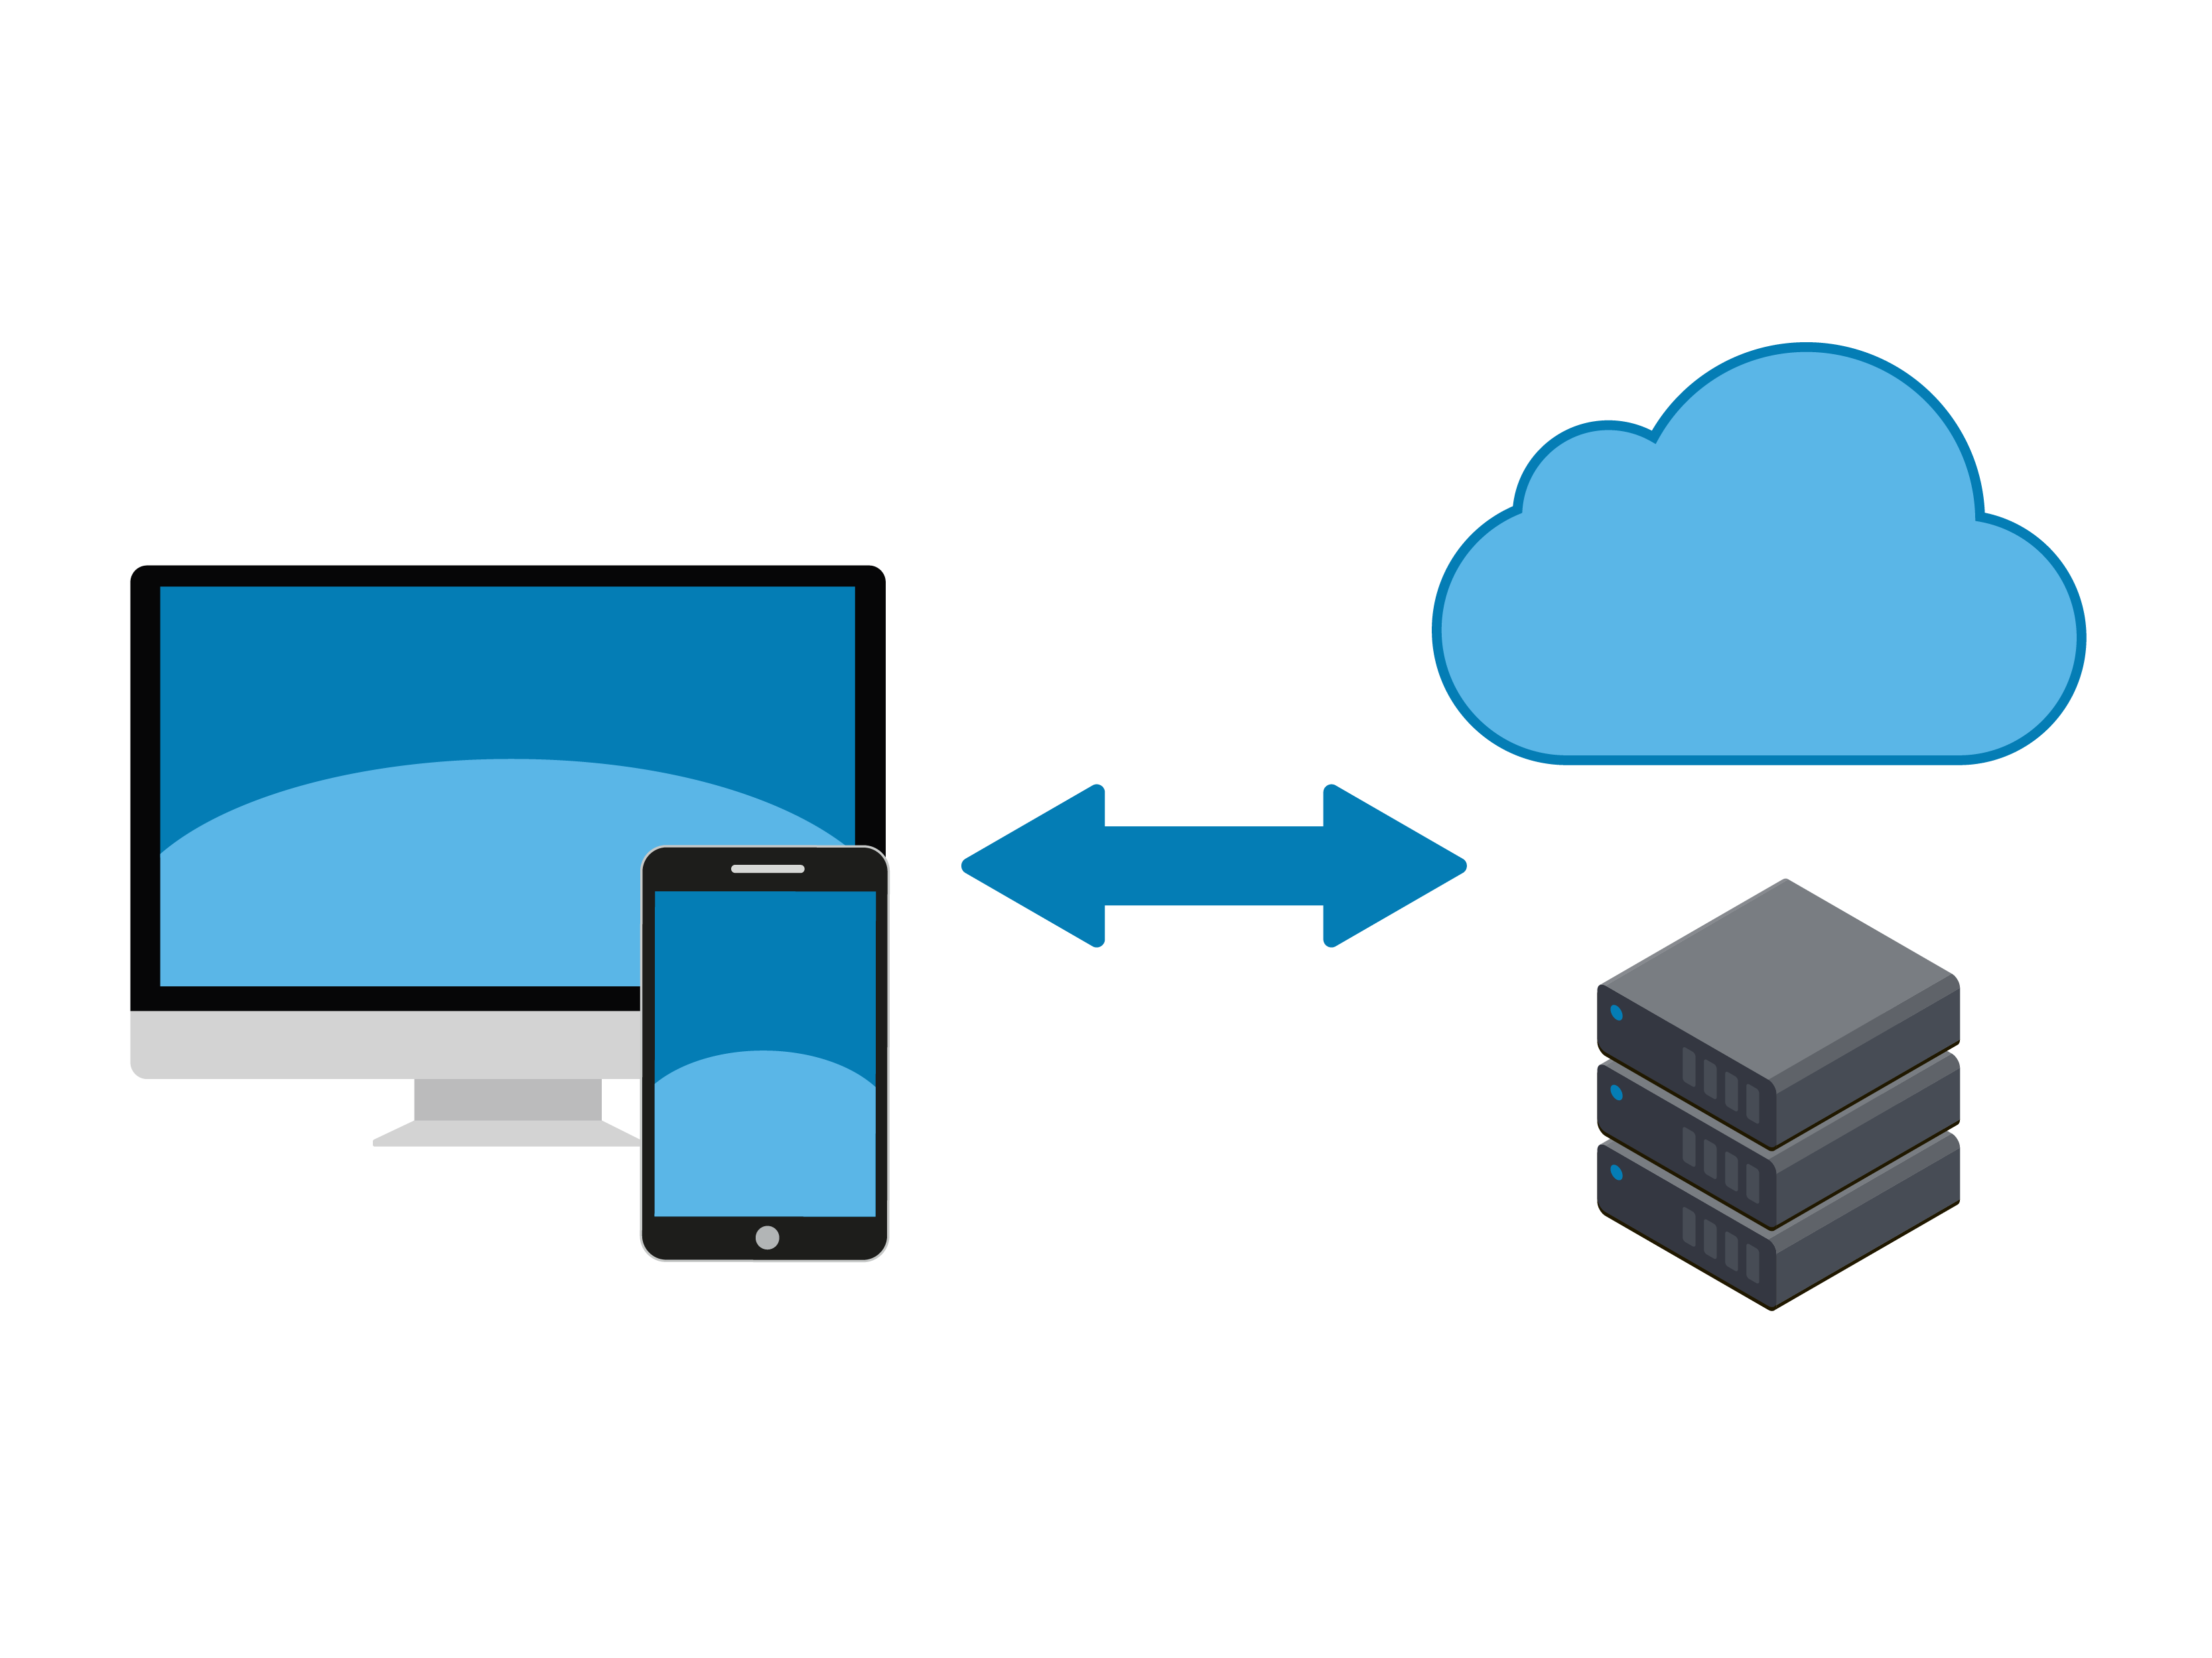
Business Recovery Planning (BCP) IT/OT Recovery
TIME: 03:00 (3AM)
Do you have a Business Continuity Plan to restore Critical Business Processes?
Do you have an IT/OT system/data backup and recovery plan?
Do you have vendors (and/or consultants) who can help you with IT/OT recovery?
Have you identified who will make the decision to use BCP vs. IT/OT recovery?
Notes:
Your company will have to ensure they are prepared to be able to recover your OT systems and components
Ask yourself if you have a Business Continuity Plan to restored business functions and define IT and OT recovery requirements
Determine if you have procedures and data backup processes that will enable you to recover OT and IT systems
Ensure that you have determine the role of externals parties, like vendors and consultants, who need to support your recovery effort AND have these parties under contract to ensure they show-up in a reasonable time based on your business needs
Your company must also determine who will make the final decision on recovery alternatives. This is typically the ICS4ICS Incident Comamnder

Slide 37
BCP/DR for IT/OT Procedure Template
Helping you deploy a process in your organization
Preparation
Business defines Business Recovery alternatives as part of BCP
  Perform BIA to defined requirements
Business defines IT/OT recovery requirements
  Define Recovery Time Objectives
  Define Recovery Point Objectives
IT and OT staff define backup and recovery processes and procedures
  Estimate Recovery Time
Process
Incident Commander works with business to invoke Business Recovery in the short-term
Operations Section Chief (CIRT) evaluates DR solutions to estimate IT/OT recovery time
  IT and OT recover of each system or component may differ
  Backup data may have been damaged
Operations Section Chief (CIRT) also evaluates eradicating (removing) malware
Incident Commander works with business to make decision on Business Recovery vs. IT/OT Recovery vs. Eradication (remove) malware
Notes:
The company must prepare to be able to restore operations which may include recovery of OT Systems and Components
Prior to an incident, a Business Impact Analysis (BIA) is performed with business staff to determine if the business can be recovered manually AND to define the RTO which is the length of time your business operations can be down ALONG with the RPO which define how much data that can be lost if the systems and data are recovered
IT and OT staff define backup and recovery process to meet the business defined requirements
They will provide an estimated recovery time that may not meet the business requirements. The business must be informed so they can make decisions.
During an incident the Incident Commander works with the business to use business recovery alternatives in the short-term
The Operations Section evaluates the DR solution and possible corruption of backup data caused by the malware. Malware often destroys backup data
They will define a likely recovery time to restore OT and IT systems and components
Operations also works to evaluate eradication options to remove the malware. This is often the shortest path to recovery
The IC will decide on the option or options to take to restore normal business operations

Slide 38

Command and General Staff Meeting
Notes:
We will talk about the first meeting that brings together the entire ICS4ICS Team
The technical people on the Operations Section Team will continue to work on the cyber incident while the ICS4ICS meetings occur

Slide 39
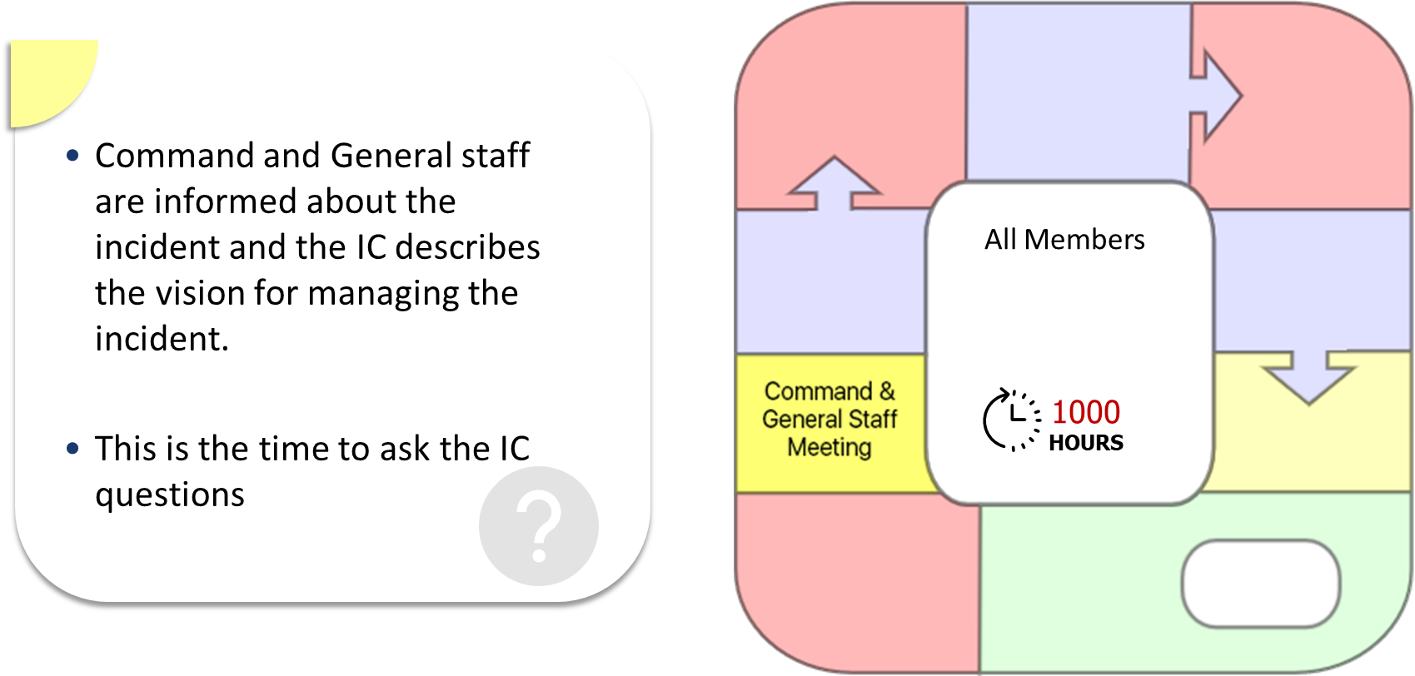
Command & General Staff Meeting: Overview
TIME: 04:00 (4AM)
0400
Notes:
The Command & General Staff Meeting will start at after each ICS4ICS team members has had time to arrive at the site or online
This meeting provides time for the Incident Commander, Command Staff like PIO and SOFR, and the General Staff, the Section Chiefs, to ask questions and get aligned on the current situation and initial incident response plans
This meeting is an open environment where ICS4ICS Team members can air dirty laundry and ask questions
The Incident Commander defines the length of the operational period (typically 12-hours) which will determine when the 2nd shift starts working on their shift
The Incident Commander reminds Section Chiefs that they are responsible for performing actions within their section for positions that have not been staffed
Section Chiefs will identify roles within their teams they want to fill
The Incident Commander will approve positions along with all joint ICS4ICS decisions

Slide 40
Command & General Staff Meeting
Agenda
Command and General Staff Meeting Agenda
SPEAKER | TOPIC
PSC (as SITL) | Situation Briefing
IC | Objectives Review / Current Priorities
IC | Functional Tasks – assignments to Command and General Staff
PSC | Roundtable Discussion Clarify priorities, objectives, assignments; Identify/review resource needs; Discuss concerns/issues
PSC | Review Open Action Items
IC | Closing Comments
Notes:
The Planning Section Chief will facilitate this meeting using a pre-defined agenda they modify based on the specifics of the incident
All people on the ICS4ICS team will join this meeting to get information on the incident and directions from the Incident Commander
The Planning Section Chief on-boards team members as they arrive onsite or online
The team members begin to develop their individual plans based on their teams’ role and the incident specifics
They will also start draft a tactical plans that will be approved by the Incident Commander at a later meeting
The Planning Section Chief will facilitate the meeting including reviewing the agenda, taking notes, and then close the meeting

Slide 41

Command & General Staff Meeting
Safety Status
Notes:
The Safety Officer will present status of safety situation
They describe safety concerns and mitigation strategies to address those concerns
They will provide the team with directions on how they MUST operate to ensure their teams’ and everyone’s safety
They will submit a Resource Request to order things needed to ensure safety, like an ambulance, security staff, and other resources
At each meeting, the Safety Officer will keep the ICS4ICS team updated as further safety risks and concerns develops and updates to the safety plan

Slide 42
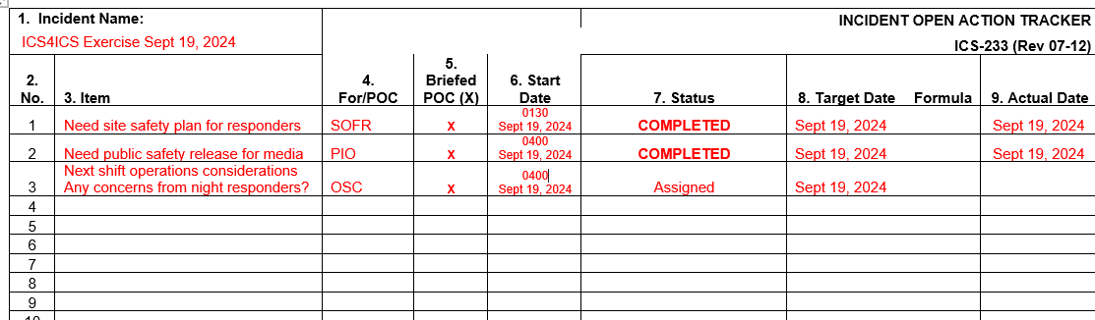
Command & General Staff Meeting
ICS-233 Incident Open Action Tracker
Notes:
The Planning Section Chief will continue to capture and update action items prior, during, and after meetings.
This data will be used to ensure that everyone knows their assignments and ensure all tasks are completed
This document also acts as a memory for actions have been completed which will be used to onboard the ICS4ICS Team 2nd Shift
In this example, several action items were captured for various people to perform
NOTE: SOFR (Safety Officer), PIO (Public Information Officer), OSC (Operations Section Chief)

Slide 43
Investigation Results
TIME: 04:00 (4AM) - Technical Status of investigation and alternatives
Bad actor infected the ECDIS system from the memory stick
  The technician used to perform routine maintenance
Bad actor logs on to system
  Via remote access solution leveraging Weak passwords & MFA was not turned on for remote connections
  Default passwords are typically changed
Bad actor enumerates network and systems
Bad actor obtained access ECDIS Transfer Machine
The ransomware software is time delayed
  Was launch after the OT system was infected
Notes:
The Operations Section report the results of the cyber incident response investigation
… <<read bullets>> …

Slide 44
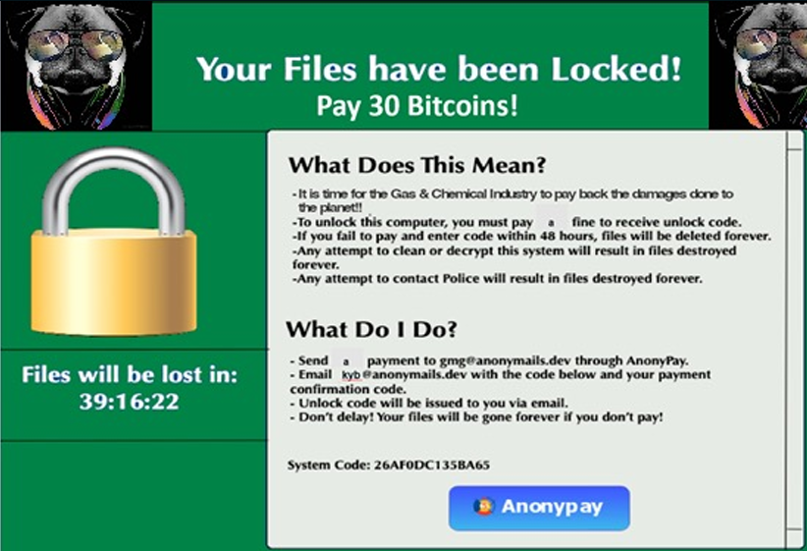
Ransomware Demand
Working together to decide how to respond
Notes:
Ransomware is becoming a significant risk to numerous industry sectors. In some sectors we are seeing over 100% increase annually in ransomware attacks
The bad guys have become very effective at these types of attacks with Ransomware-as-a-Service being used to improve their capabiltiies
These incidents are challenging because the bad guy locks your systems. They may destroy your backup data used to recovery OT and IT systems and components.

Slide 45
Ransomware Demand
Questions to ask yourself
Do you have procedures to manage a ransomware incident?
Do you have procedures to operate your ship manually and restore OT systems?
  Who assessments these alternatives?
Have you identified the parties who will make the ransomware decisions?
Do you understand the company policies, laws and regulation that impact decisions about paying ransomware?
Notes:
Your company should determine if they are prepared to respond to Ransomware before an incident occurs
Do you understand the procedures defining how to respond including the decision processes which should include company policies, laws and regulations, and other factors that impact the ransomware decision?
Do you have procedure to operate your business without OT and IT systems in the short-term until those systems can be restored?
Have you identified teams that will assess alternatives including: BCP, remediation, and OT and IT DR?
Do you know who will make the ransomware decision?

Slide 46
Ransomware Procedure Template
Decision Team
Incident Commander
Operations Section Chief
Intelligence Officer (Ops Section)
Safety Officer
Technical Reps/Eng of systems
Corporate Cyber Security
Corporate Legal/outside council
Government Relations
Cyber Insurance Rep, if covered
Public Information Officer
FASC and/or Corp Finance
Privacy expert, if needed
Decision Process (defined prior to incident)
Understand restriction of paying ransomware
  Review Corporate Policies which may prohibit payment
Assess ransomware impact: safety, env, business/financial, and impact to company IT and communications
Document a business case for ransomware decision
Understand recovery alternatives / times vs. alternatives to eradicate (remove) malware
Assess likelihood payment works (see URL)
Develop communications strategy, if needed
Align with government reporting
Ensure company has ability to make payment
Identify ransomware approval processes
  Authorized approver (defined by CMT)
Notes:
The ICS4ICS website has a Ransomware Procedure Template that can be used by your company to quickly document your specific ransomware processes.
This procedure defines the company policies, laws, regulations, and other factors that impact ransomware decisions
A company must establish a decision team that exercises the Ransomware procure periodically. Several people provide input like the IC, OSC, IO, SOFR, Tech Reps, Corp Cyber Security, and others.
You may need to hire external legal counsel who specializes in Ransomware. A contract should be signed prior to an incident.
The Government Relations person likely is critical to the decision process and may be the appointed Decision Maker
If you have cyber insurance that covers Ransomware, their rep will need to be part of the decision team
The PIO will collect data that can be used in future communications.
Finance/Admin Section Chief would need to be prepared to make a crypto currency payment
The Decision Process guide the Decision Team which includes understanding restrictions that prevent payments, assessing impact to your company which is part of the documented business case for the decision, and understanding alternatives to paying.
There is a free website that allows you to assess the likelihood that your systems will be released if you pay ransom. There may be no release code that works.
As you communicate information about the ransomware you must understand the bad guys likely will also get these messages.
Finance must ensure they can pay crypto currency.
The Crisis Mgmt Team which is C-level executives must define who will make the ransomware payment decision

Slide 47
Ransomware Demand
Ransomware demand is received
Bad actor has deleted most critical data from critical systems
  Backup data likely was also deleted
  ECDIS is not available and cannot be fixed with existing procedure (legal required)
The ship cannot operate manually
Notes:
… <insert speaker notes> ….

Slide 48
Getting Involved in ICS4ICS
Notes:
We will talk more about some of the other activities we are still work on to improve the ICS4ICS Program.

Slide 49
ICS4ICS and you
How can you get involved?
Visit or website: www.ics4ics.org
Register for the ICS4ICS Newsletter
Observe or Participate or Host an ICS4ICS exercise
Attend training and obtain ICS4ICS Credentials
Join an ICS4ICS team to help define the processes, training, etc.
Consider presenting ICS4ICS at a future event
Contact Brian Peterson bpeterson@isa.org for more information
Notes:
You are welcome to get involved with ICS4ICS efforts.
You will find all materials on the ICS4ICS website including procedure templates, guides, exercise materials, videos, training and credentialling information, and many other resources.
Consider registering to receive the ICS4ICS Newsletter so you can follow our progress and provide input to shape the program.
Participate or Host an ICS4ICS exercise. We can develop an exercise specific to your industry sector.
You can easily obtain your ICS4ICS Credentials by attending 15-hour of free FEMA training.
We are always looking for people to join the ICS4ICS Team to contribute developing materials for the program.
We are always looking for people to present ICS4ICS at various events.
Please submit the “Join” form on the ICS4ICS website or contact Brian Peterson if you want to get involved.

Slide 50
Q&A
Notes:
We have time for some questions
If you are not able to get your questions answered please contact Brian Peterson

Slide 51
References

Slide 52
References
Obtain more information about Marine Cyber Incidents
Cyber Guidance: https://ww2.eagle.org/content/dam/eagle/publications/brochures/Cybersecurity_16053.pdf
Cyber Guidelines: https://www.bimco.org/-/media/bimco/about-us-and-our-members/publications/ebooks/guidelines-on-cyber-security-onboard-ships-v4.ashx
Cyber Safety Principles: https://ww2.eagle.org/content/dam/eagle/rules-and-guides/current/other/250_cybersafetyV1/CyberSafety_V1_Cybersecurity_GN_e.pdf
Cyber Safety Data Integrity: https://ww2.eagle.org/content/dam/eagle/rules-and-guides/current/other/252_cybersafetyV3/CyberSafety_V3_Data_Integrity_GN_e.pdf
Cyber Future: Jack Voltaic 2.0 Gives a Glimpse of Future Infrastructure Protection | AFCEA International
  JackVoltaic_ExecSummary_R12 (Final).pdf (afcea.org)
Cyber Incidents: https://www.m-cert.fr/admiral/
Cyber Attacks: https://www.nhlstenden.com/en/maritime-cyber-attack-database
Cyber Exercise: DoD-Cyber-Table-Top-Guide-v2.pdf (cto.mil)
NIMS/ICS: CG+NIMS+AC+Guide+Apr+2016.pdf (squarespace.com)
CIRT: https://nvlpubs.nist.gov/nistpubs/SpecialPublications/NIST.SP.800-61r2.pdf

Slide 53
References
Obtain more information about Marine Cyber Incidents
ECDIS: Electronic Nautical Charts (ENC) and Electronic Chart Display and Information Systems (ECDIS) (imo.org)
ECDIS: Performance Standards for Electronic Chart Display and Information Systems (ECDIS)
Cyber Radio (IEC 63154): https://webstore.iec.ch/en/publication/61003
Cyber Navigation and Radio (IEC 61162): https://webstore.iec.ch/en/publication/93754

Slide 54
ISAGCA

Slide 55
ISA Cybersecurity Resources
Free guidance, training, and more:
ISA Global Cybersecurity Alliance - www.isagca.org A collaborative forum to advance OT cybersecurity and understanding of ISA/IEC 62443 | ISASecure www.isasecure.org The world’s leading conformance certification program for ISA/IEC 62443 | ICS4ICS www.ics4ics.org Improve how cybersecurity incidents are managed with training, processes, and exercises
Get involved:
ISA/IEC 62443 standards available from ISA (free access with ISA professional membership!)
Cybersecurity training and certificate program
Help develop the standard – open to all at no charge – www.isa.org/ISA99

